Slide 1

E PROJECT:
Alberto Clocks
Developer Guide

Slide 2
E PROJECT GROUP MEMBERS
Students Name
Students ID
Tooba Khan
Student1729672
Alvina
Student1731026
Yusra Ilyas
Student1729666
Urooj Fatima
Student1730903
Faculty Name: Sir Maaz Rahim
Coordinator Name: Miss Ashna Nasir

Slide 3
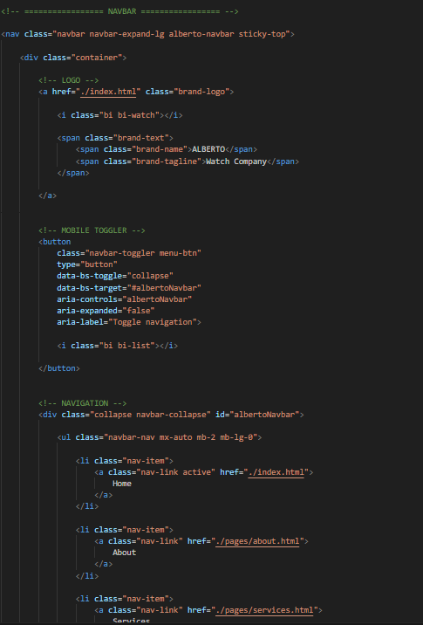
NAVBAR

Slide 4
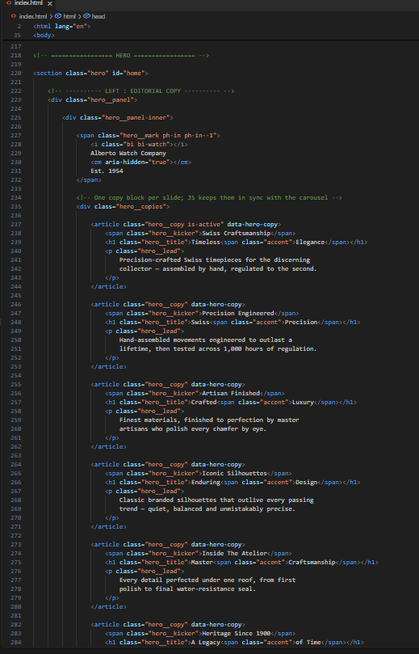
HOME PAGE

Slide 5
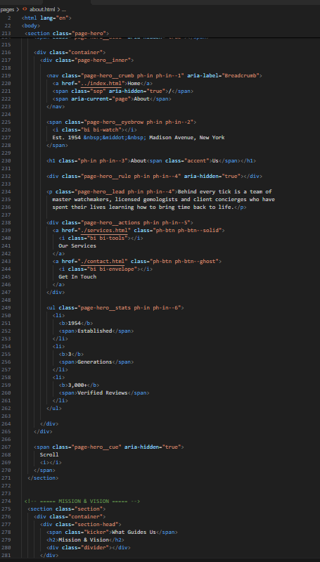
ABOUT PAGE

Slide 6
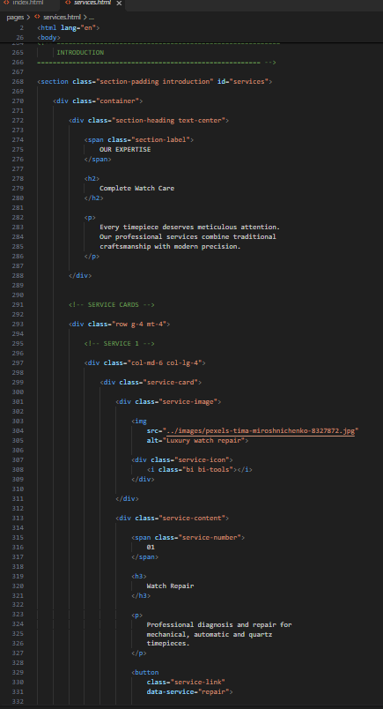
SERVICES PAGE

Slide 7
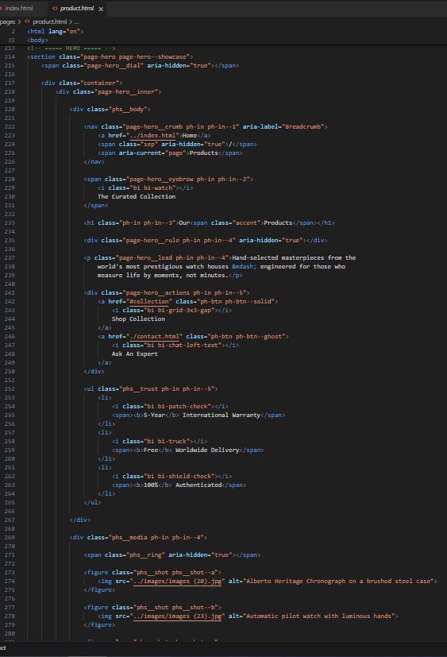
PRODUCT PAGE

Slide 8
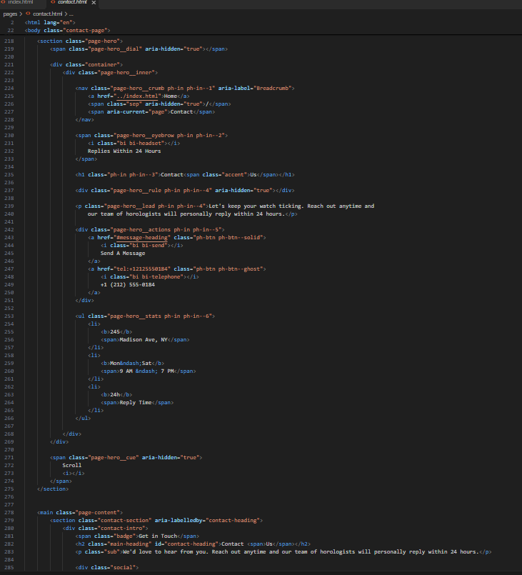
CONTACT PAGE

Slide 9
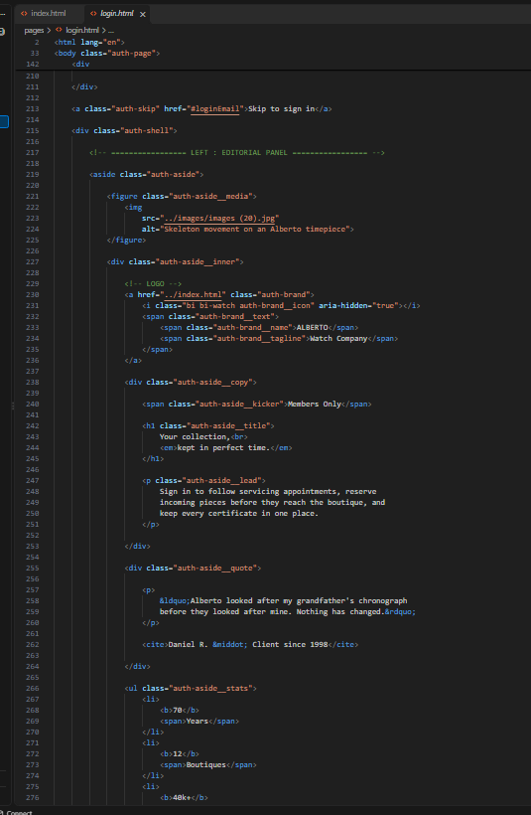
LOGIN PAGE

Slide 10
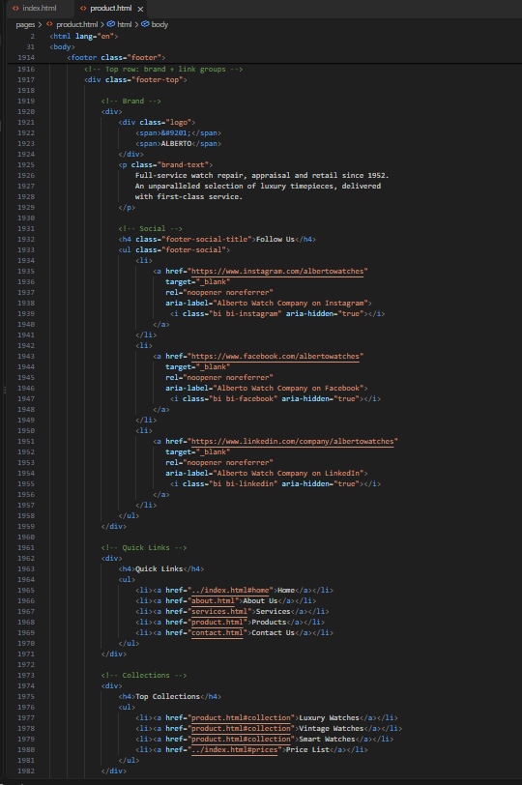
FOOTER

Slide 11
MEMBERS CONTRIBUTION
Name
Page
Tooba Khan
HOME , PRODUCT & LOGIN PAGE
Alvina
ABOUT & CONTACT PAGE
Yusra Ilyas
SERVICES PAGE
Urooj Fatima
CONTACT PAGE & FOOTER

Slide 12
THANK YOU

